Slide 1
M4

Slide 2
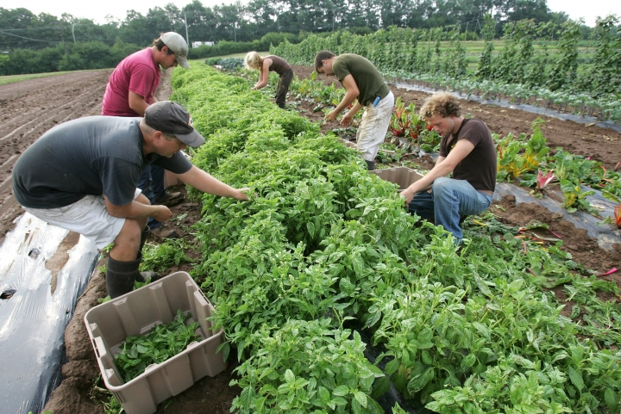
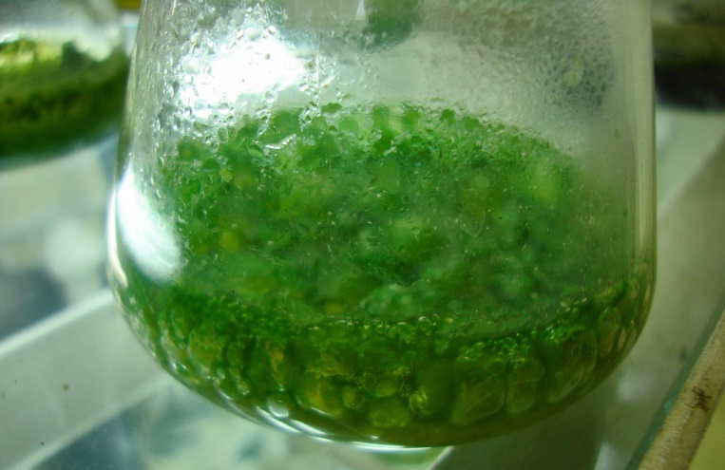
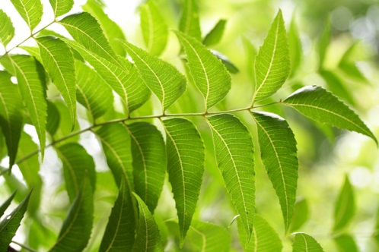
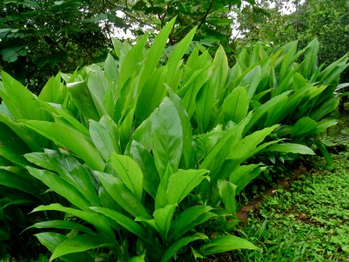
Organic farming :
Organic farming is a farming system with minimal or no use of chemicals as fertilizers, herbicides, pesticides etc.
It uses organic manures, recycled farm-wastes (straw and livestock excreta).
It also use as bio-agents such as culture of blue green algae in preparation of biofertilizers.
Use as neem leaves or turmeric specifically in grain storage as bio-pesticides.
Living agents used as fertilizers.

Slide 3
2. Irrigation :
India has a wide variety of water resources and a highly varied climate.
Supplying water artificially
Under such conditions, several different kinds of irrigation systems are adopted to supply water to agricultural lands depending on the kinds of water resources available.
These include well, canals, rivers and tanks.
Let us see them one by one.

Slide 4
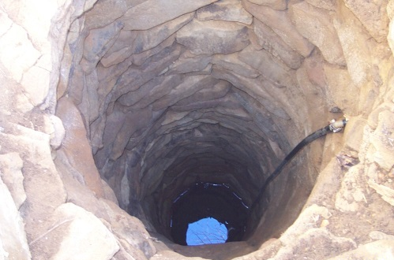
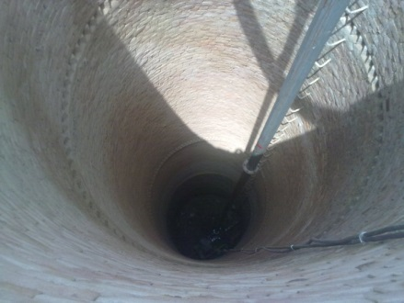
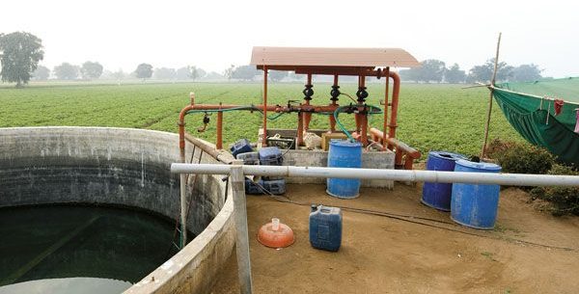
Wells :
There are two types of wells namely dug wells and tube wells.
In a dug well, water is collected from water bearing strata.
Tube wells can tap water from the deeper strata.
layers
From these wells, water is lifted by pumps for irrigation.

Slide 5
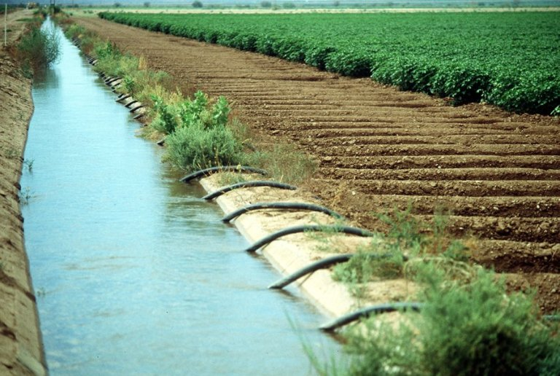
Canals :
This is usually an elaborate and extensive irrigation system.
In this system canals receive water from one or more reservoirs or from rivers.
The main canal is divided into branch canals having further distributaries to irrigate fields.

Slide 6
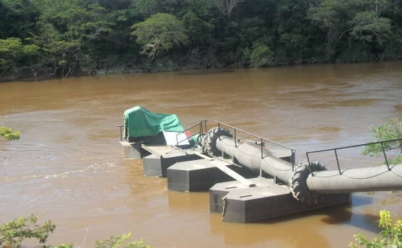
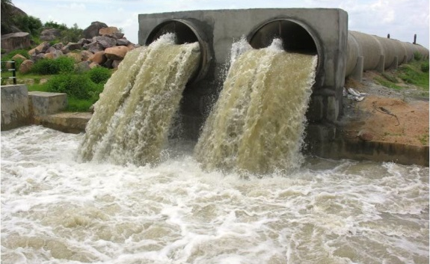
River Lift Systems :
In areas where canal flow is insufficient or irregular due to inadequate reservoir release, the lift system is more rational.
Water is directly drawn from the rivers for supplementing irrigation in areas close to rivers.

Slide 7
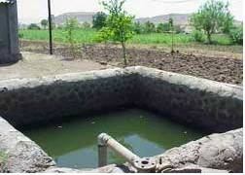
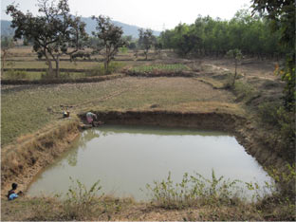
Tanks :
These are small storage reservoirs, which intercept and store the run-off of smaller catchment areas.
Obstruct
Flowing water
The area from which rainfall flows into a river, lake, or reservoir.

Slide 8
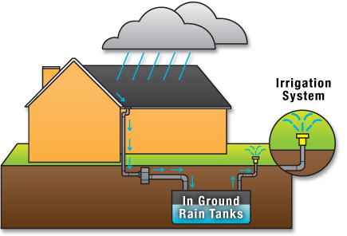
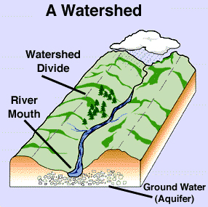
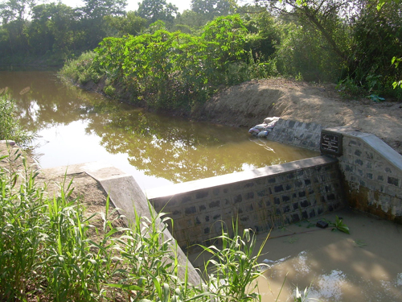
Fresh initiatives for increasing the water available for agriculture include rainwater harvesting and watershed management.
This involves building small check-dams which lead to an increase in ground water levels.
The check-dams stop the rainwater from flowing away and also reduce soil erosion.

